Slide 1


Prliminary findings and recommendations
WHO rabies mission
12-14 February 2018 - Tbilisi, Georgia

Slide 2
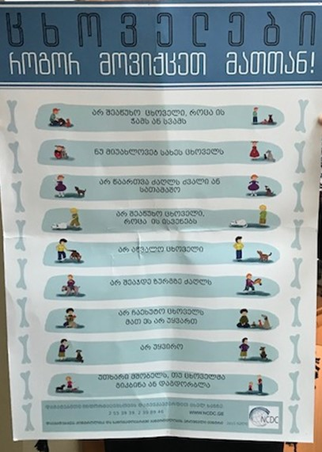
Objectives mission
Request of the MoH to conduct a situational analysis of Georgia’s rabies programme activities, to:
propose options for more prudent use of PEP
support elaboration of the national rabies strategy
strengthen engagement with other sectors, ‘One Health’ approach
elucidate role of the private sector in rabies control

Slide 3
Overall Findings
Strong committment by all stakeholders to control and eventually eliminate rabies
Steps taken to improve cross-sectoral collaboration
Functioning Public Health System (at all levels)
Launching of enhanced rabies control activities in the past few years
Measurable impact (e.g. 0 human cases for 3 years)
Existance of a regulatory framework and plans for a national rabies strategy
Increasing legal obligation of municpalities to address stray animal issues, including health and animal welfare

Slide 4
Findings Human Health sector
No human cases since 2015
No biologics stock outs at PEP clincs
Extremely high number of exposures and PEP
Ranking 5th worldwide (estimates Hampson et al 2015)
Thorough data collection on human rabies exposures, acute encephalitis syndrom surveillance
Well developped network of antirabies facilities, (61) accross the country
It appears that national criteria for PEP are not uniformely followed

Slide 5
Findings Animal Health sector
NFA strategic plan for the control of rabies 2015 – 2018
Since 2013 implementation of mass vaccination campaigns (owned dogs/cats) with increasing coverage
Improved surveillance on animal rabies, performant laboratory diagnosis
74% reduction in dog rabies cases since 2013
Draft national strategy post 2018 under development, submitted to OIE
Institutional divide for responsibilities for dogs - owned versus stray dogs
Coordination with private veterinary clinics is weak

Slide 6
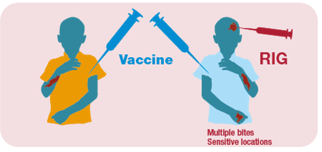


Collboration between sectors and stakeholders
Human: public
Human: private
10 days observation
10 days observation
Municipality
Animal Health:
Public
Private veterinary clinics

Slide 7
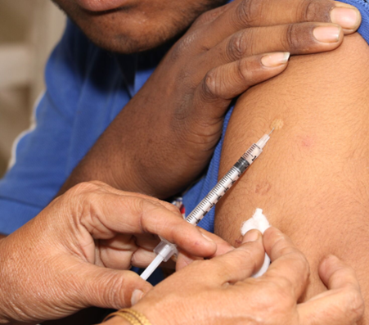

Preliminary Recommendations I
Need for a joint elaboration of a national rabies strategy
Enhance cross-setoral collaboration at ALL levels, across the entire country
Review of operational protocols/ SOPs on rabies
Review of risk assessment for exposures
Review and more detailed elaboration of SOPs and indications for PEP
Indications for rabies pre-exposure prophylaxis
Switch to cost-, dose and time saving ID administration of PEP
Choice of human quality vaccine (PQ or product from a manufacturer with other PQ products)
Maintain awareness campaigns, with particular emphasis on bite prevention
Strengthen joint investigations of rabies suspect bites exposures (‘integrated bite case management’)

Slide 8

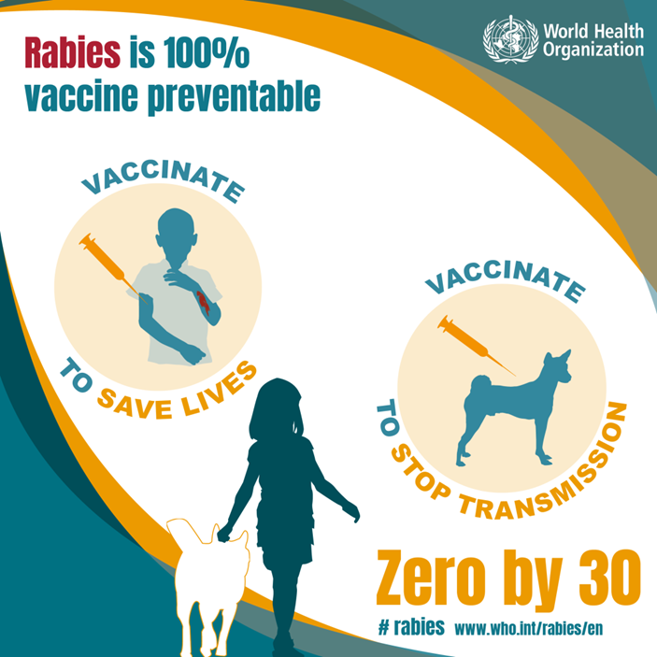
Preliminary Recommendations II
Quality assurance plan for rabies diagnostic laboratories
Reach higher vaccination coverage for all dogs throughout the country as a first step
Legally engage private veterinary clinics in rabies control activities
Identify and engage NGOs and private sector as rabies stakeholders
Enforce regulatory measures and follow up on non-compliance accross the country
Identify needs for capacity building
Investigate role of wildlife in local rabies epidemiology, before planning oral vaccination campaigns

Slide 9
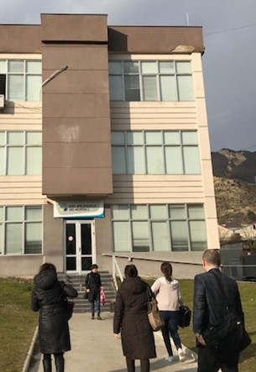
Institutions visited
NCDC
NFA
Public health centre (Tbilisi Municipality)
Private clinic in Mtskheta with participation of regional public health centre staff
Private immunization centre in Tbilisi
US-CDC

